Slide 1
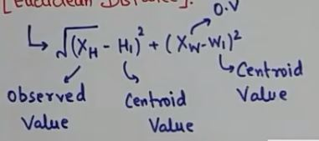
K-means
Divide the given sample data in 2 clusters using k-means(Euclidean Distance)
Euclidean Distance

Slide 2
K-means
Divide the given sample data in 2 clusters using k-means(Euclidean Distance)
Height (H) | Weight (W)
185 | 72
170 | 56
168 | 60
179 | 68
182 | 72
188 | 77
180 | 71
180 | 70
183 | 84
180 | 88
180 | 67
177 | 76

Slide 3
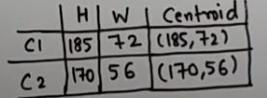
K-means
Step 1: Initialise two clusters
C1= {1,
C2= {2,

Slide 4
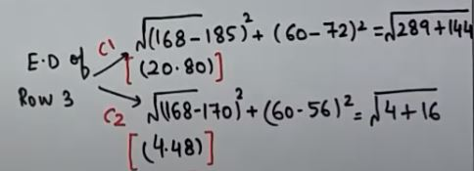
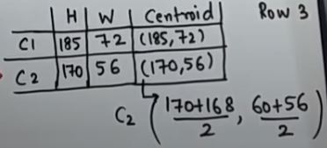
K-means
Height (H) | Weight (W)
185 | 72
170 | 56
168 | 60
179 | 68
182 | 72
188 | 77
180 | 71
180 | 70
183 | 84
180 | 88
180 | 67
177 | 76
Step 2: E. Distance of Row 3:
C1= {1,
C2= {2, 3
C2= [169, 58]

Slide 5
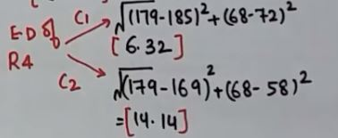

K-means
Height (H) | Weight (W)
185 | 72
170 | 56
168 | 60
179 | 68
182 | 72
188 | 77
180 | 71
180 | 70
183 | 84
180 | 88
180 | 67
177 | 76
Step 2: E. Distance of Row 4:
C1= {1,4
C2= {2,3

Slide 6
K-mediod
i | X | Y
X1 | 2 | 6
X2 | 3 | 4
X3 | 3 | 8
X4 | 4 | 7
X5 | 6 | 2
X6 | 6 | 4
X7 | 7 | 3
X8 | 7 | 4
X9 | 8 | 5
X10 | 7 | 6

Slide 7
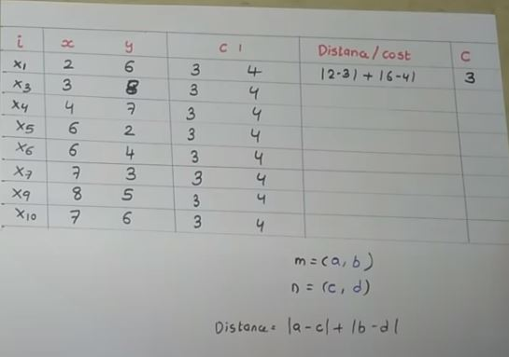
K-mediod
StEP 1: Select 2 randon clusters
C1= (3, 4)
C2= (7, 4)

Slide 8
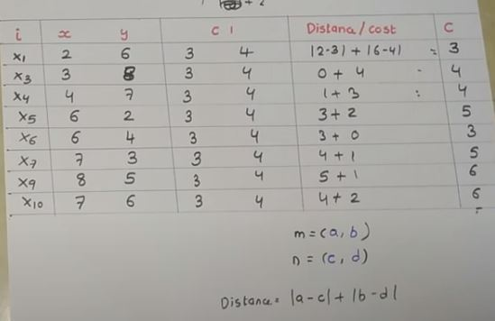
K-mediod
StEP 1: Select 2 randon clusters
C1= (3, 4)
C2= (7, 4)

Slide 9
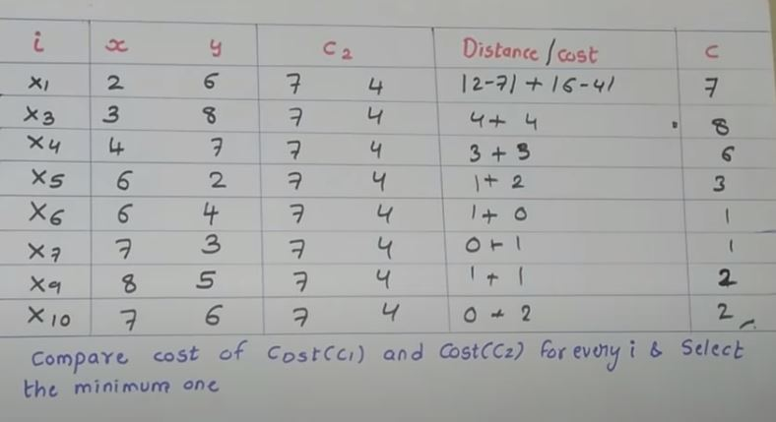
K-mediod
StEP 1: Select 2 randon clusters
C1= (3, 4)
C2= (7, 4)

Slide 10
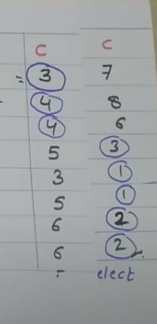
K-mediod
StEP 1: Select 2 randon clusters
C1= (3, 4)
C2= (7, 4)

Slide 11
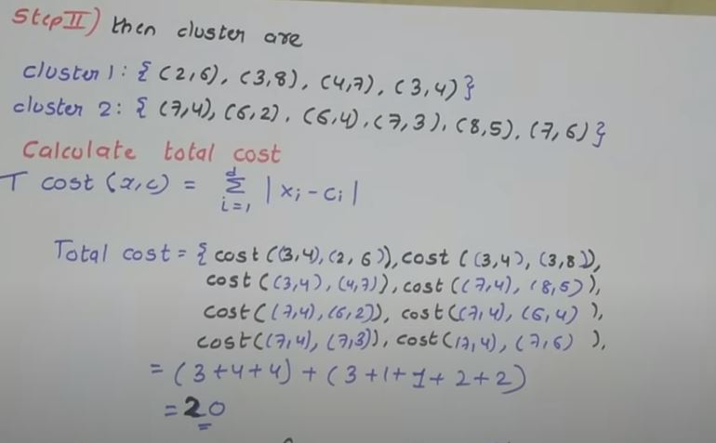
K-mediod
StEP 2

